Slide 1
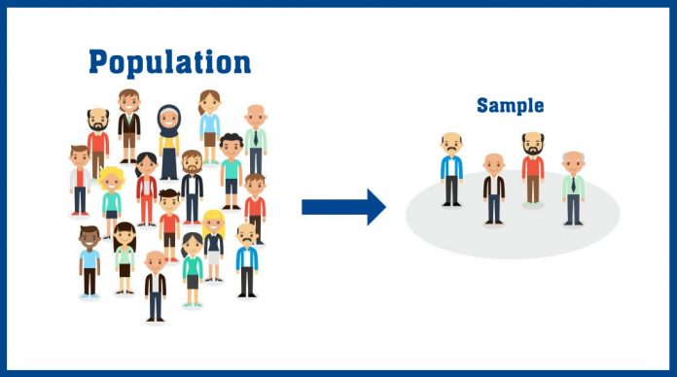
Statistical Sampling techniques
Prepared by Tony Vu (tue.vu@datdyn.com)

Slide 2
Why Sampling?
US Bureau of Labor Statistics (BLS) releases a monthly Consumer Price Index (CPI) report to measure the inflation
The BLS refers to a variety of sources to calculate CPI, including the prices of goods and services from about 23,000 retail and service establishments throughout the U.S. It also collects data from about 50,000 landlords and tenants to determine the changes in the price of rent.
=> a handful of samples which considered to be enough to represent entire US: Sampling techniques

Slide 3

Why Sampling for DataDyn?
Thousands of customers
Billions of files to scan
Hundred of file types
Peta/Tetrabytes of data
Purpose:
- how do data owner know which files to keep/pay attention to or which to remove within shortest duration?
- data management optimization

Slide 4
Sampling techniques:
Statistical Sampling
Probability Sampling
Non-Probability Sampling
Random Sampling
Weighted Samping
Stratified Sampling
Cluster Sampling
Systematic Sampling
Multistage Sampling
Convenient Sampling
Quota Sampling
Snowball Sampling
Judgement Sampling

Slide 5
Sample data
The survey collect information of 10,000 people with different properties:
Age
Gender
Height
Weight
Blood type
..
For DD, it can be referred to meta data:
File size
File type
Last access
Tag
Sensitivity
Etc…

Slide 6

1. Statistical Sampling 1.1. Probability Sampling
Probability method utilizes some form of randomization.
In this method, all samples have a chance of being selected
More expansive than non-probability and more time consuming
Benefit: selected sample represent the entire populations
Notes:
Color represents 1 variable, gender for example

Slide 7
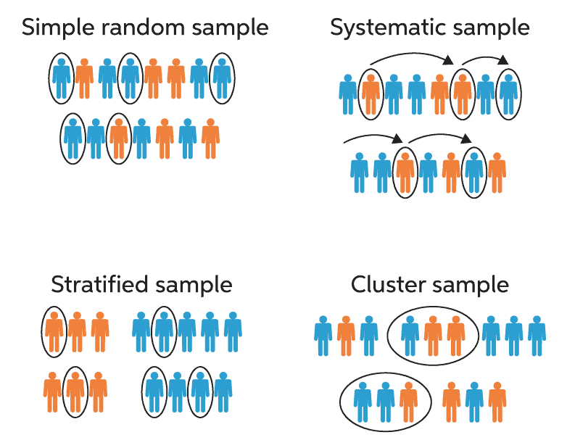
1. Statistical Sampling 1.1. Probability Sampling - Random Sampling
Each member of the population has an equal chance and probability of being selected
Notes:
Color represents 1 variable, gender for example

Slide 8
1. Statistical Sampling 1.1. Probability Sampling - Systematic Sampling
The starting point is selected randomly, but then the subsequent samples following systematic pattern
Choosing the first person at arbitrary index 10, and then choose the next person at index 20, 30, 40, etc…

Slide 9
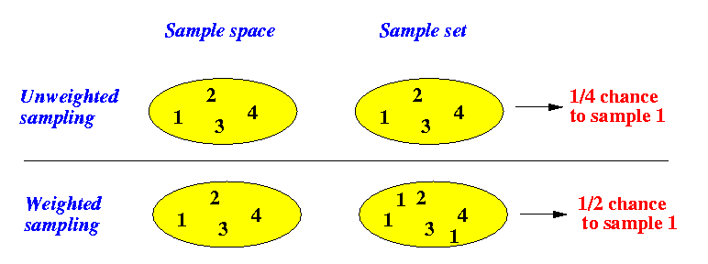
1. Statistical Sampling 1.1. Probability Sampling - Weighted Random Sampling
A sample in which each Sampling unit has been pre-assigned a weight so it has more/less chance to be selected

Slide 10
1. Statistical Sampling 1.1. Probability Sampling - Stratified Random Sampling
Involve 2 or more steps sampling.
- The first step, split entire population into 2 or more groups (strata) based on certain characteristics (age group, gender group, race group)
- From each strata group, apply random sampling to select samples

Slide 11
1. Statistical Sampling 1.1. Probability Sampling - Cluster Sampling
Involve 2 or more steps sampling.
- The first step, split entire population into N number of clusters/groups that having same characteristic as the population
- Apply random sampling, stratified sampling or another cluster sampling to the selected clusters
- The approach of 2 or more cluster sampling is called multi-stage cluster sampling

Slide 12
1. Statistical Sampling 1.2. Non-Probability Sampling
This non-probability approach depends on the data owner/judgement self perspective, therefore, often do not represent the entire population
Notes:
Color represents 1 variable, gender for example

Slide 13
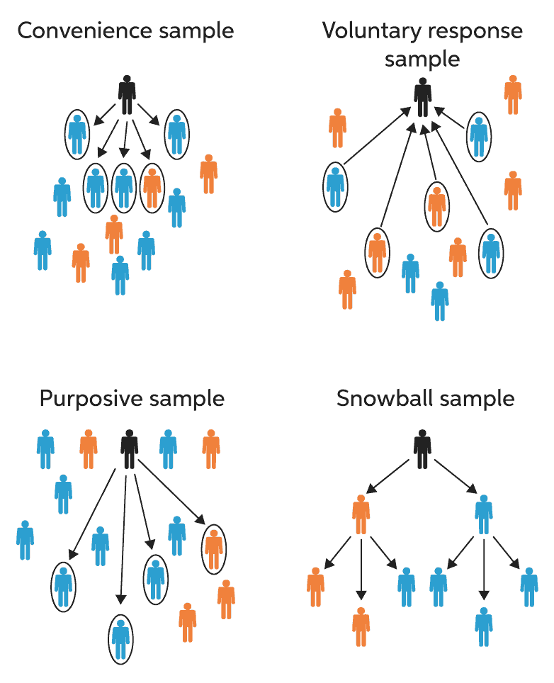
1. Statistical Sampling 1.2. Non-Probability Sampling - Convenient Sampling
The most popular method in non-probability sampling
- The samples are selected based on the nearest distance/most convenient: for example, you want to study the entire company employees, so you choose your own department as the sample to represent.

Slide 14
1. Statistical Sampling 1.2. Non-Probability Sampling - Quota Sampling
Combine of non-random sampling with Convenient Sampling selection of a predetermined number or proportion of units. This is called a quota.
You first divide the population into mutually exclusive subgroups (called strata) and then recruit sample units (based on Convenient) until you reach your quota. These units share specific characteristics, determined by you prior to forming your strata.

Slide 15
1. Statistical Sampling 1.2. Non-Probability Sampling - Voluntary Sampling
Another popular non-prob sampling method, based on the voluntarily.
- For example: to get the sample from entire university, you ask for the volunteers from students.
The good: you may have more students that you don’t know/(better than convenient)
The bad: the sample might be skewed because students who volunteers are good learner)

Slide 16
1. Statistical Sampling 1.2. Non-Probability Sampling - Purposive/Judgement Sampling
Involve the selection of researcher/data owner then based on his/her purpose, the group is further sampled down.
For example: to select only B grade and above students as sample for entire school (for academic purpose)

Slide 17
1. Statistical Sampling 1.2. Non-Probability Sampling - Snowball Sampling
Involve the selection of new group based on the selection of old group,
It is similar to chain or network sampling, where the sample is further expanded based on previous selection.
Applications: recruitment

Slide 18
Probability vs Non-probability Sampling
Probability Sampling | Non-probability Sampling
Samples are drawn from larger population based on probability theory | Samples are chosen by researchers based on subjective judgement
Computational expensive and Time consuming | Easy and quick to collect data
Used for research which is conclusive | Used for research which is exploratory
Hypothesis assumed prior to sampling and the objective is to validate the hypothesis | Hypothesis is derived later by conducting research study based on the sample collected
The methods that best suits DD to put at Zubin dashboard would be Probability Sampling.
The technique chosen should be either Stratified Random Sampling (preferred) or Cluster Sampling

Slide 19
2. Sample size
How to choose the right sample size for infinite?
Population: all the samples available in the pool.
i.e: all metadata files (billions), all US population (300M), etc.
Marginal Error (confident interval): defines how much error is acceptable, normally around 5%
Confident level:
Determine the actual mean falls within, common are 90%, 95%, 99%
Population Proportion:
Covers the variance in the survey, a safe number is 0.5
Notes:
Confident level is the percentage of times you expect to get close to the same estimate if you run experiment again or resample the population in the same way
Confident interval consists the upper and lower bound of the estimate you expect to find at given level of confident
For example, among the high school of 1000 students, the mean score of math subject is 80.
We build a sample of these 1000 students with expecting that it is 95% students of the time catching the right estimate (confident level).
The range of estimation would be around 5% (confident interval) from the mean which has the range of 77.8-82.2

Slide 20
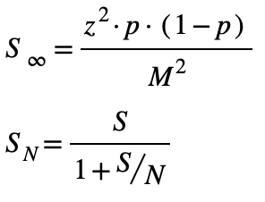
2. Sample size
Confidence Level | 95%
p | 0.5
Margin Error | 0.05
Population Size | 1000
α | 0.05
z-score | 1.96
Sample size from infinite | 384
Sample size from Population | 277
With infinite or very large population, the Sample sizes with above variables are about 384
With revised sample size of N=1000, the Sample sizes would be 277
Notes:
With infinite or ver

